Slide 1


Team 25 - ChatJackets
Notes:
Amit
As our market and customer needs continue to rapidly evolve, we’ve embraced change, identified opportunities, and have made headway to become a more competitive and agile company.
Our company’s Transformation supports our strategy as we streamline, modernize and invest so we can always operate from a position of strength.
We’ve identified six mega trends that we believe will have the biggest impact on our business. Each of those megatrends creates both opportunities, but as well challenges for us in the future…

Slide 2
Agenda
Topics
Introductions
Project Summary
Technical Solution
Business Solution
Demo
FAQ
Notes:
Amit

Slide 3

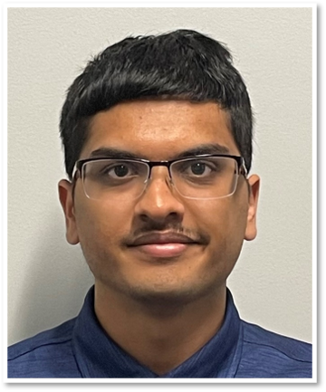

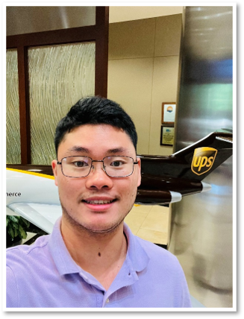

Introductions
Fatima Dineh
Role: Project Management Intern
SDG: IHS
Amit Kulkarni
Role: IT Intern
SDG: IHS
Amogha Thodpunuri​
Role: IT Intern​
SDG: IHS
Jinsong Peter Zhen
Role: IT Intern
SDG: IHS
Deepak Mattipalli
Role: IT Intern
SDG: IHS
Notes:
Individual

Slide 4

Project Overview
8/15/2023
4
Notes:
Deepak

Slide 5
The Problem

Slide 6
Project Summary
Overview
The Problem:
Employees need access to various services during their time at UPS.
Ex. Laptop Admin Rights, Azure DevOps, Database, etc.
Access to these services are currently handled on a case-by-case basis
Notes:
- Deepak

Slide 7

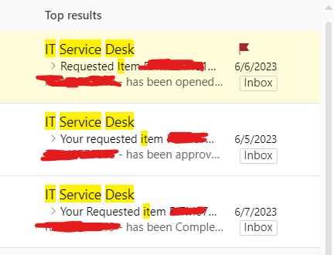

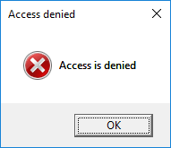
Visual Summary of the Problem
Manual Service Request
Takes up a lot of time!

Slide 8
The Solution

Slide 9



Visual Summary of the Solution
Onboarding
Faster access!
Takes survey and gets recommendations
Notes:
Fatima

Slide 10
Solution
Business
This solution works best for new UPS employees in the onboarding phase.
Employees take a survey which recommends services they may need access to based on their position, level, and historical data.
Manager(s)/lead(s) can approve the services more quickly based on the recommendations which means that new employees get faster access to the tools they need and can begin work sooner.
Notes:
Fatima

Slide 11
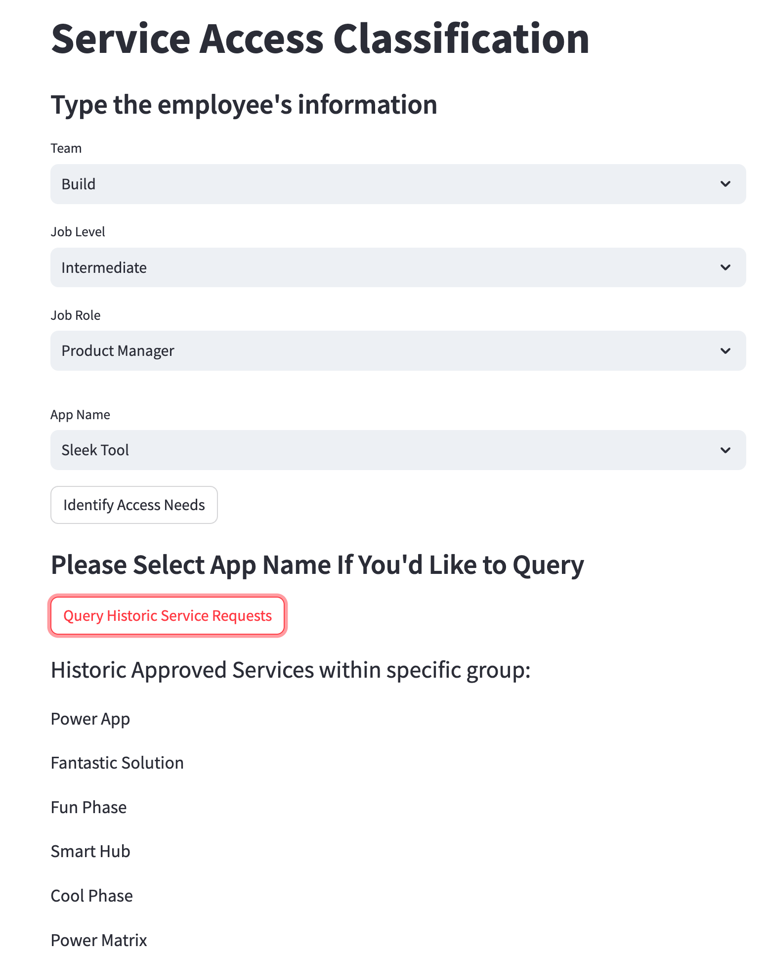



Solution
Technical – Web App Design, Model Prediction & Visualization
Notes:
Amit

Slide 12

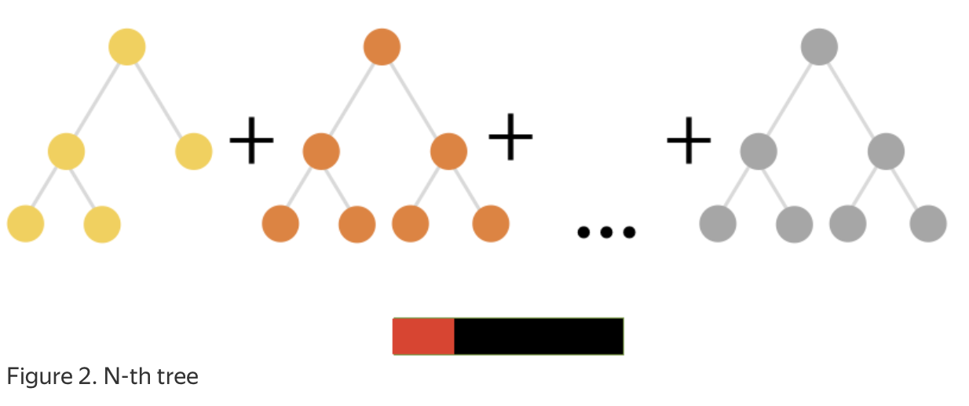
Solution
Technical – Web App Design, Model Prediction & Visualization
Fit CatBoost classifier with a dataset for App Service Request
Team Functionality: Run and Build
Job Level (Seniority): Intern, Junior, Intermediate
Job Role (Job Title): DevOps Engineer, App Developer, UX Designer, Data Engineer, ML Engineer, Data Scientist, QA Developer, Product Manager, Business Analyst
App Names: 30 app samples
Result: 54 unique job positions
Action: Approved / Denied
Notes:
Amogha

Slide 13
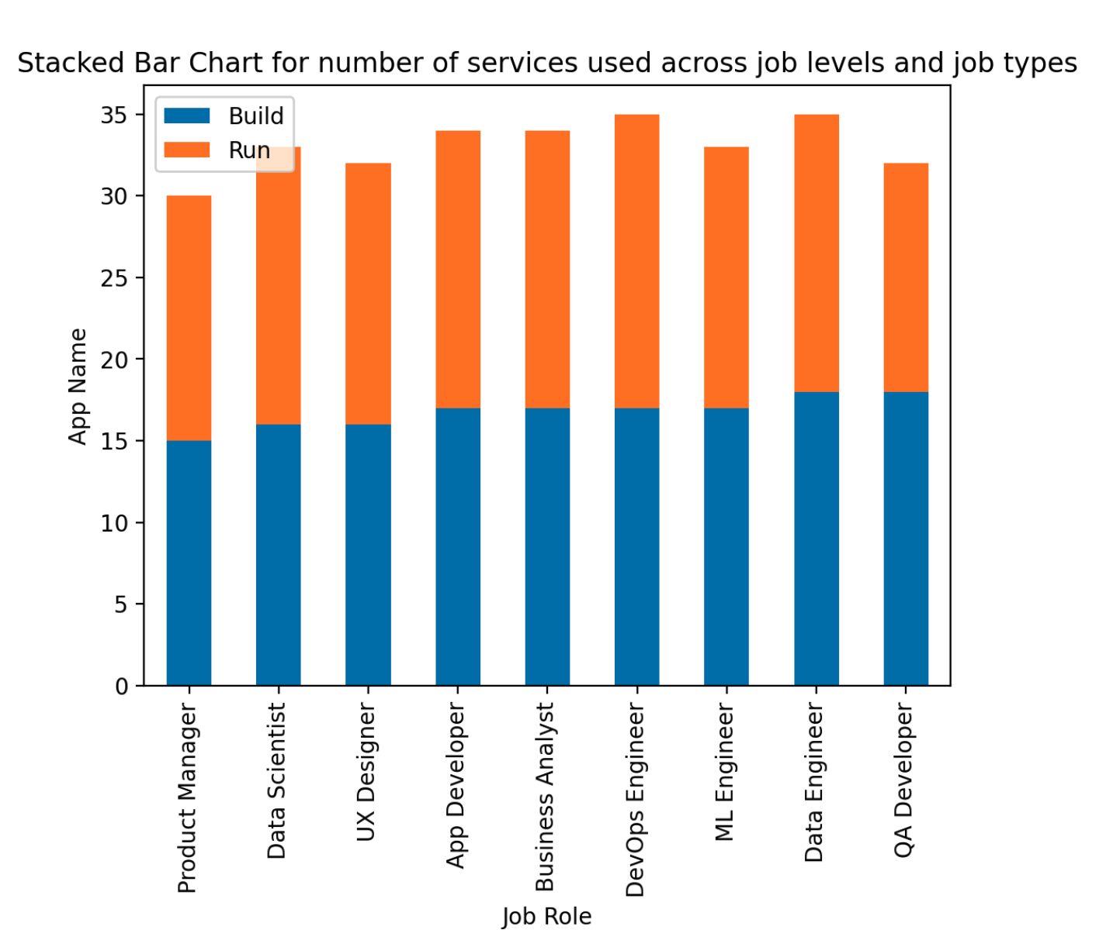
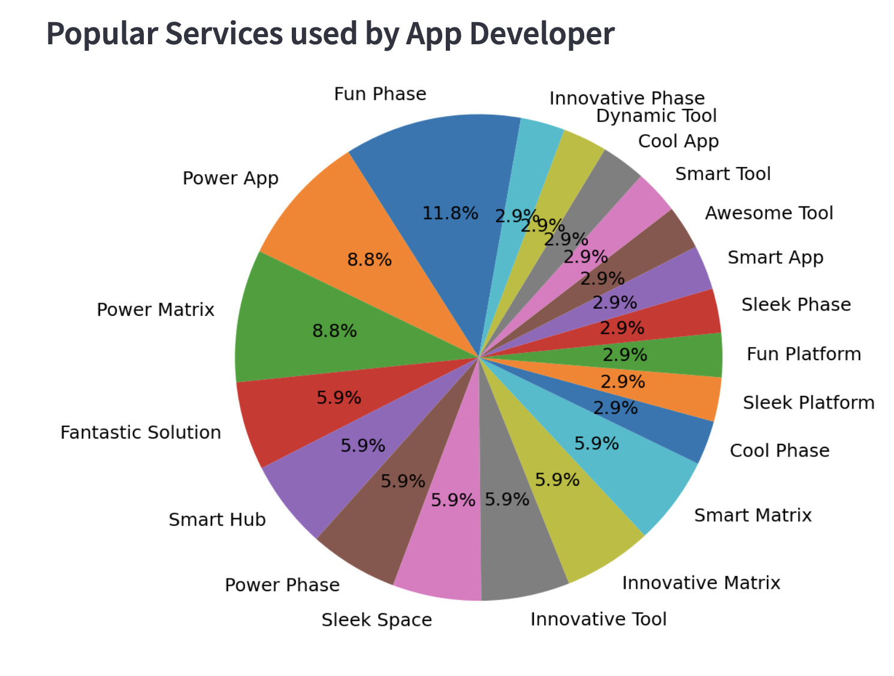
Solution
Technical – Web App Design, Model Prediction & Visualization
Notes:
Amogha

Slide 14
Demo

Slide 15
Demo

Slide 16

Questions?

